Slide 1
Unit Test Let’s write some code
Michał Jankowski

Slide 2
Long TERM PLAN
The beginning
Jasmine
Let’s write some code
Advanced topics

Slide 3
Goal of Training
You will be able to start writing some unit tests in your projects.

Slide 4
PLAN
Unit test frameworks presentation
Working with code
xUnit
Moq / NSubstitute
Test running and debugging
Coverage report
Best practices – one more time

Slide 5
Before we start – REASONS TO WRITE UNIT TESTS
Reduces bugs in new and existing features
Detect regressions
Are good documentation
Reduce the cost of change
Improve design
Allow refactoring
Constrain features / presents code contract
Defend against other developers
Speed up whole delivery process
Notes:
Link: http://www.onjava.com/pub/a/onjava/2003/04/02/javaxpckbk.html
We hope that by writing this article we can dispell these myths and encourage programmers to do the right thing and write tests!
Tests Reduce Bugs in New Features
We advocate writing tests as you write new code. Tests do not eliminate bugs, but they dramatically reduce the number of bugs as you add new features.
Tests Reduce Bugs in Existing Features
With well-tested code, introducing new features rarely breaks existing functionality. If a new feature breaks existing functionality, existing tests fail immediately, allowing you to pinpoint the problem and fix it. Without the tests, you may introduce a bug that is not found for days or weeks.
Tests Are Good Documentation
A concise code example is better than many paragraphs of documentation. We see this time after time in our consulting work. Far too often, teams produce boilerplate documents that are of little practical value. When programmers need to learn an API, they search for code examples. Tests are among the best code examples because they are concise snippets of code that exercise public APIs.
Tests Reduce the Cost of Change
Tests make it easier to change software because you have confidence that changes do not break existing functionality. When you have good test coverage, you have confidence to explore new design ideas without fear of introducing new bugs.
Poorly-tested software becomes increasingly expensive to change as time goes on. Risk increases dramatically as the system becomes more complex because it becomes more and more likely that changes inadvertently break things that used to work.
Tests Improve Design
Writing tests forces you to make your code testable. Specifically, you tend to rely less on dubious patterns like singletons and global variables, instead making your classes loosely-coupled and easier to use. Code that is tightly-coupled or requires complex initialization is hard to test.
Tests Allow Refactoring
With tests, you are more able to change code throughout the lifetime of an application. Tests provide a safety net, allowing you to refactor at any time without fear of breaking existing code, so you can constantly improve the design of your program.
Tests Constrain Features
Far too often, programmers build fancy frameworks rather than deliver features customers want. When you adopt a test-first approach, you start by writing tests for the current feature. You then implement the feature. When the tests pass, you know you can stop and move to the next feature. Well-tested applications are more easily extended; therefore, you don't have to anticipate what the customer will eventually request.
Tests Defend Against Other Programmers
Textbook code is simple, but real-world problems are hard. We find that in real applications, you often encounter very subtle bugs due to Java bugs, quirky business rules, operating system differences, etc. These bugs may only manifest themselves under very peculiar scenarios.
Let's suppose you find that a payroll calculation routine removes a zero from everyone's salary, but only if the routine runs at 11:59 PM on New Year's Eve. Now, suppose that the bug fix involves a single-line code change.
Without a test, another programmer may come in and change that code. Unless they run the application at 11:59 PM on New Year's Eve, they won't know that they just re-introduced the bug and will cause countless bounced checks next year. With a test, however, you can ensure that when the programmer changes the code, the test breaks and informs the programmer of the problem.
Testing Is Fun
If you thrive on challenges, then testing is a lot of fun. Coming up with automated tests is difficult, requiring creative solutions for complex problems. Just like coding is an art, testing is an art.
In many organizations, testing is relegated to the least-experienced programmers. We often encounter the misconception that testing consists of people completing written checklists as they manually execute the application. This approach is completely unscalable, because it takes longer and longer for humans (monkeys?) to test every feature as the application grows.
Modern OO languages like Java are complex, particularly when it comes to dependencies between classes. One change can easily introduce bugs in seemingly unrelated classes. Gone are the days when each character-based screen is a standalone program. OO apps are far more complex and demand automated tests.
Writing automated tests is harder than writing the code itself, in many cases. The most expert programmers are the best testers. When faced with seemingly mundane coding tasks, coming up with creative tests provides an intellectual challenge that expert programmers thrive on.
Beginners typically need expert assistance when writing tests. This is where pair-programming helps, because experts work side-by-side with beginners as they learn the art of testing.
Testing Forces You to Slow Down and Think
When adding a new feature or refactoring an existing solution, testing forces you to think about what the code is supposed to accomplish. By writing tests first, you think about how to use the public API and what the ultimate outcome should be. Thus you end up with a clean and simple design that does exactly what you expect it to do.
Testing Makes Development Faster
On a class-by-class basis, testing slows you down. It takes time to think about and produce good tests. But as time goes on, your overall velocity increases because you are not constantly worrying about breaking existing code as you add new features.
We have also found that with good tests, we can ignore internal implementation details during the first iteration. Provided that we get the public API right, we can improve internal design and algorithms later, again without fear of breaking something. We have used this specifically for things like sorting algorithms. In the first iteration, we do something quick and dirty, like a bubble sort. We can always come back later and replace it with a better algorithm, if necessary.
Tests Reduce Fear
One of the biggest fears that programmers encounter is making a change to a piece of code and not knowing what is going to break. Having a complete test suite allows programmers to remove the fear of making changes or adding new features. We have found that we do not hesitate to change and improve well-tested code, whereas we fear changing untested code.

Slide 6
UNIT TestS FRAMEWORKS

Slide 7



Different approaches
Create test as method
Create test as object
Unit
MSTEST
Installation by NuGet
Notes:
As method:
More procedural style
Easier to start / understand
You need to use more attributes
As object
Similar to normal development - OOL
Easier to start for developers
Does everybody knows NuGet?

Slide 8
My first test With method APPROACH
using NUnit.Framework;
[TestFixture]
public class CalculatorTest
{
[SetUp]
public void SetUp()
{
// We will setup everything here - executes before each test
}
[Test]
public void Given_FirstNumberIs5_When_Add6_Then_ResultIs11()
{
// Code of unit test
}
[TearDown]
public void TearDown()
{
// Cleaning actions - executes after each test
}
}
Notes:
It is possible to run some code before all tests once time -

Slide 9
My first test OBJECT APPROACH
using Xunit;
public class CalculatorTest : IDisposable
{
public CalculatorTest()
{
// We will setup everything here - executes before each test
}
[Fact]
public void Given_FirstNumberIs5_When_Add6_Then_ResultIs11()
{
// Code of unit test
}
public void Dispose()
{
// Cleaning actions - executes after each test
}
}
In production code please implement IDisposable in correct way: https://msdn.microsoft.com/pl-pl/library/system.idisposable(v=vs.110).aspx

Slide 10
Unit
https://xunit.github.io/

Slide 11
My FIRST UNIT TEST

Slide 12
SOME CODE THAT WE WOULD LIKE TO TEST
public interface IDateTimeProvider
{
DateTime Now { get; }
}
public class YearProvider
{
private readonly IDateTimeProvider dateTimeProvider;
public YearProvider(IDateTimeProvider dateTimeProvider)
{
this.dateTimeProvider = dateTimeProvider;
}
public int CurrentYear => this.dateTimeProvider.Now.Year;
}
Notes:
DateTime wrapper injected in constructor
Dependency injection

Slide 13
Arrange act assert
[Fact]
public void TestMethodName()
{
// Arrange
...
// Act
...
// Assert
...
}

Slide 14
Let’s TRY TO BUILD TeST STEP BY STEP – THE NAME
[Fact]
public void TestMethodName()
{
// Arrange
...
// Act
...
// Assert
...
}

Slide 15

HOW WE SHOULD NAME OUR TEST
Given_Preconditions_When_StateUnderTest_Then_ExpectedBehavior
Based on naming convention developed as part of Behavior-Driven Development (BDD).
Break down test into three parts: preconditions, system under test and expected behaviours
Example:
Given_UserIsAuthenticated_
When_InvalidAccountNumberIsUsedToWithdrawMoney_
Then_TransactionsWillFail
Notes:
This is our recommendation in Objectivity. Test name describe test in easy way and readable way. This naming convention should improve cooperation between testers and developers.
Naming is also connected with AAA pattern:
Arrange = Given
Act = When
Assert = Then

Slide 16
TEST ATTRIBUTE
[Fact]
public void Given_DateIsIn2016Year_When_GetCurrentYear_Then_Return2016()
{
// Arrange
...
// Act
...
// Assert
...
}

Slide 17
FACT & THEORY
Facts are tests which are always true. They test invariant conditions.
[Fact]
public void Given_DateIsIn2016Year_When_GetCurrentYear_Then_Return2016()
Theories are tests which are only true for a particular set of data.
[Theory]
[InlineData(2000)]
[InlineData(2012)]
[InlineData(2016)]
[InlineData(2100)] // Failure
public void Given_YearIsLeap_When_CheckingIfIsLeap_Then_ReturnsTrue(int leapYear)
Notes:
nUnit:
[TestCase(12,3, Result=4)]
[TestCase(12,2, Result=6)]
[TestCase(12,4, Result=3)]
public int DivideTest(int n, int d)

Slide 18
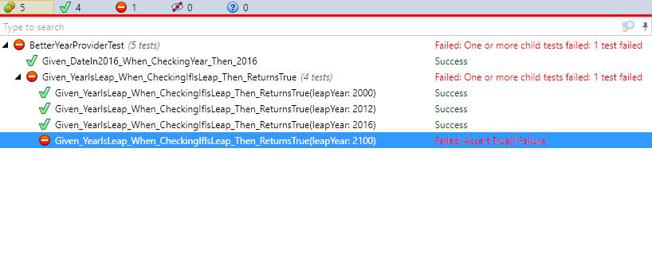
RESULTS of PREVIOUS TESTS
Notes:
Point that Theory will be splitted into several test cases.

Slide 19
We can Now prepare ARRANGE
[Fact]
public void Given_DateIsIn2016Year_When_GetCurrentYear_Then_Return2016()
{
// Arrange
...
// Act
...
// Assert
...
}

Slide 20
IN THIS CASE it CAN LOOK like THIS
// Arrange
const int ExpectedYear = 2016;
var dateTimeProviderMock = new Mock<IDateTimeProvider>();
dateTimeProviderMock.Setup(x => x.Now)
.Returns(new DateTime(ExpectedYear, 10, 1));
var provider = new YearProvider(dateTimeProviderMock.Object);
Notes:
Mention that sometimes this code can be insert in constructor in xUnit

Slide 21
Next step ACT
[Fact]
public void Given_DateIsIn2016Year_When_GetCurrentYear_Then_Return2016()
{
// Arrange
const int ExpectedYear = 2016;
var dateTimeProviderMock = new Mock<IDateTimeProvider>();
dateTimeProviderMock.Setup(x => x.Now)
.Returns(new DateTime(ExpectedYear, 10, 1));
var provider = new YearProvider(dateTimeProviderMock.Object);
// Act
...
// Assert
...
}

Slide 22
IN MOST CASES ACT HAS one LINE
// Act
int currentYear = provider.CurrentYear;

Slide 23
LAST ITEM - ASSERT
[Fact]
public void Given_DateIsIn2016Year_When_GetCurrentYear_Then_Return2016()
{
// Arrange
const int ExpectedYear = 2016;
var dateTimeProviderMock = new Mock<IDateTimeProvider>();
dateTimeProviderMock.Setup(x => x.Now)
.Returns(new DateTime(ExpectedYear, 10, 1));
var provider = new YearProvider(dateTimeProviderMock.Object);
// Act
int currentYear = provider.CurrentYear;
// Assert
...
}

Slide 24
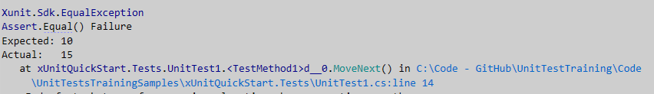
ASSERT
Assert.Equal("expectedValue", "actualValue");
Assert.Equal(10, 15);
Most of Asserts do not allow to provide error message. Test should be written in such way that it is easy to understand it.
Notes:
In nUnit – Assert.AreEqual("expectedValue", "actualValue");

Slide 25
DIFFERENT TYPES OF ASSERTS
// Item is not equal to provided
Assert.NotEqual(10, 15);
// Float comparation with defined precision
Assert.Equal(10.0f, 10.001f, 5);
// Is false
Assert.False(false);
// Is true - can be expression
Assert.True(10 < 15);
// Check null
Assert.Null(null);
Assert.NotNull(new object());
Notes:
There is possibility to use expression – we can test very sophisticated conditions. But it is not good to put in tests complicated logic. Because of that it is not recommended to do that.

Slide 26
DIFFERENT TYPES OF ASSERTS
// String ends as we expected
Assert.EndsWith("ExpectedEnding", "myStringExpectedEnding");
// We can check also type of object
Assert.IsType<List<int>>(collection);
// Check that exception has been thrown
Assert.Throws<NullReferenceException>(() => collection.Add(10));
// All items in range 10 and 100
Assert.All(collection, i => Assert.InRange(i, 10, 100));
// Collection contains element with value 10
Assert.Contains(10, collection);
// Collection is empty
Assert.Empty(collection);

Slide 27

Different TEST RESULTS MESSAGE

Slide 28
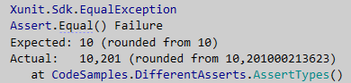
Different TEST RESULTS MESSAGE

Slide 29
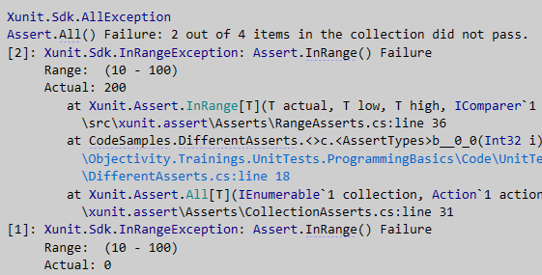
Different TEST RESULTS MESSAGE

Slide 30
ASSERT IN THEORY should have one line….
// Assert
Assert.Equal(ExpectedYear, currentYear);
Notes:
But in practice it will have more lines

Slide 31
ONcE AGAIN OUR production CODE
public interface IDateTimeProvider
{
DateTime Now { get; }
}
public class YearProvider
{
private readonly IDateTimeProvider dateTimeProvider;
public Year(IDateTimeProvider dateTimeProvider)
{
this.dateTimeProvider = dateTimeProvider;
}
public int CurrentYear => this.dateTimeProvider.Now.Year;
}

Slide 32
And our FINAL TEST
[Fact]
public void Given_DateIsIn2016Year_When_GetYear_Then_Return2016()
{
// Arrange
const int ExpectedYear = 2016;
var dateTimeProviderMock = new Mock<IDateTimeProvider>();
dateTimeProviderMock.Setup(x => x.Now)
.Returns(new DateTime(ExpectedYear, 10, 1));
var provider = new YearProvider(dateTimeProviderMock.Object);
// Act
int currentYear = provider.Year;
// Assert
Assert.Equal(ExpectedYear, currentYear);
}

Slide 33
How To Design Good Unit Test
Input parameters
Correct / wrong / boundary values
Unexpected situations
Logic
Conditionals and loops
Fail / Pass scenario
Exceptions
Output (result of function and interaction)
Correctness of result (not only correct value or behaviour)
Unit of work
Notes:
Correctness of result = expected behaviour on provided situation

Slide 34
LET’s RUN IT

Slide 35
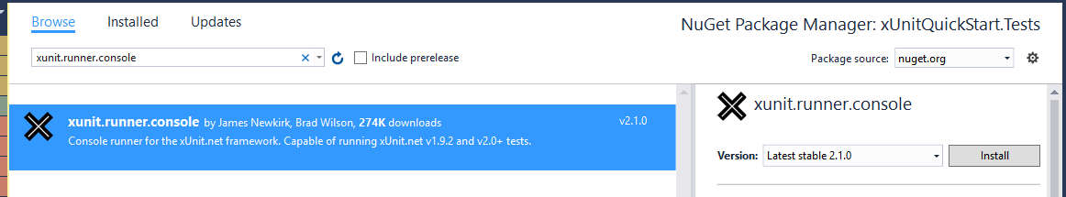
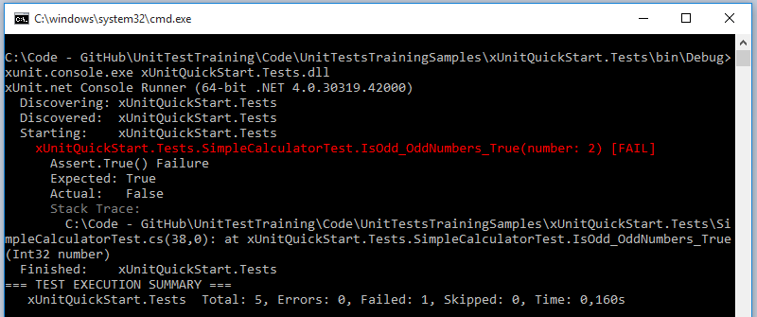
Running xUNIT TESTs - Console
Notes:
Succesful

Slide 36
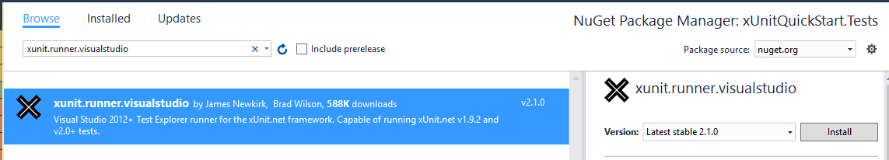
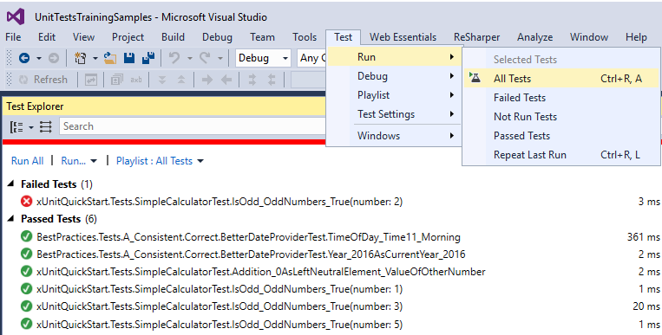
Running xUNIT TESTs – VISUAl STUDIO

Slide 37
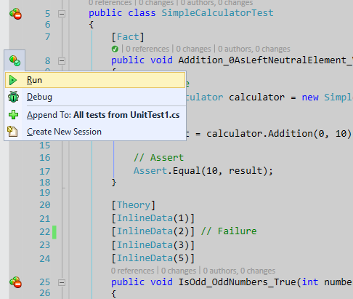
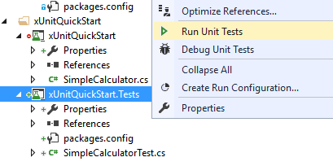
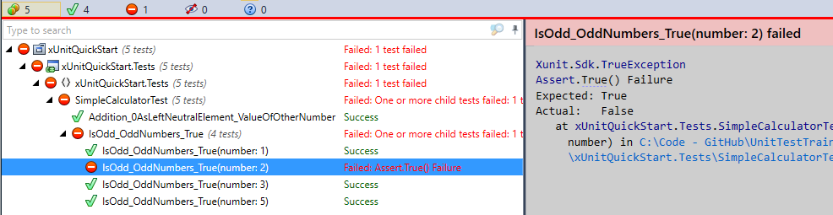
Running xUNIT TESTs - RESHARPER

Slide 38
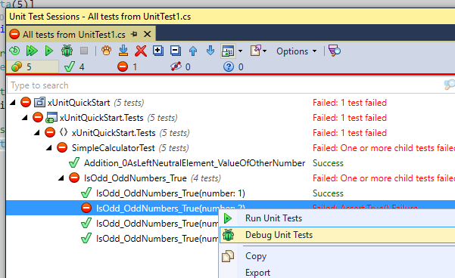
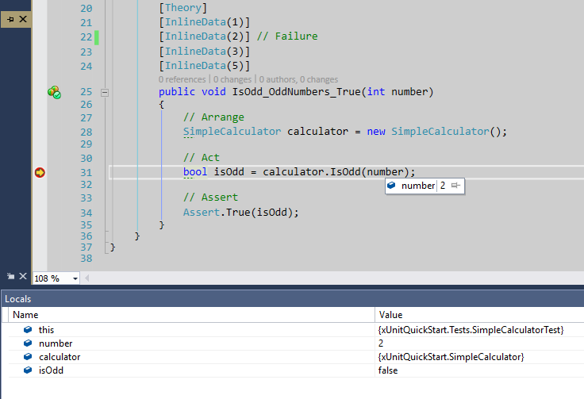
Test DEBUGGING

Slide 39

XUNIT
Let’s do this in Visual Studio
Notes:
New test project creation with references to xUnit
Simple tests with Fact:
Addition(0, 5) -> result 5
Addition(Int.Max-1, 10) -> result OverflowException
Test skipping
Theory
Passing only arguments and result is coded in test: IsOdd
Passing arguments and expected result -> Addition (a, b, result) - InlineData
Same as 3.2 but arguments provided by function -> MemberData
Test running in:
Console
Visual Studio
R#
Test debugging
Test decoration – Theory(DisplayName… ) and Trait

Slide 40
Best practices
Arrange act assert
Consistent – the same result each time
Atomic
Single responsibility
Self-descriptive
No conditional logic or loops
No exception handling
No test logic in production code
Test separation
TDD
“Know the rules well,
so you can break them effectively.”
― Dalai Lama XIV
Notes:
Test separation – show code with test - OPOPO

Slide 41
XUNIT – other Possibilities

Slide 42
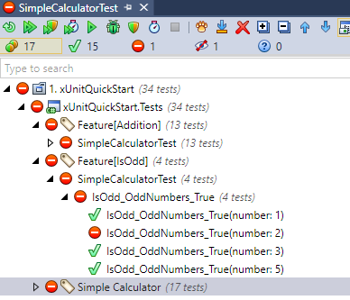
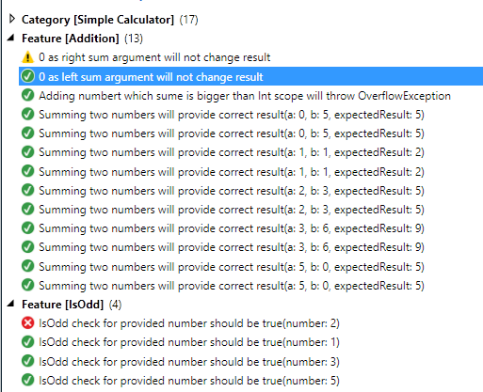
Friendly names and grouping
[Collection("Simple Calculator")]
[Trait("Category", "Simple Calculator")]
public class SimpleCalculatorTest
{
[Fact(DisplayName = "0 as left sum argument will not change result")]
[Trait("Feature", "Addition")]
public void Given_0IsNeutralElement_When_.........()
R#
Visual Studio Test Explorer
Notes:
It doen not work perfect.
Collection name will be visible in console windows – CI
Display name will be visible in TestExplorer. R# will ignore this.

Slide 43
Fluent Assertions
// Check if result is equal to 10
result.Should().Be(10);
// Check if result is smaller than 10
result.Should().BeLessThan(10);
// Check if isOdd is true
isOdd.Should().BeTrue();
// Check if result is not null
result.Should().NotBeNull();
// Check if actualResult is equal to expectedResult
actualResult.Should().Equals(expectedResult);
//Check if Addition throwed OverflowException with message
Action act = () => calculator.Addition(int.MaxValue - 1, 10);
act.ShouldThrow<OverflowException>().WithMessage("Exception message");
Notes:
Think about ‘should’ keyword. Instead of it we should use ‘must’ key word.

Slide 44
Fluent Assertions – Should Be Equivalent To
// Check the structural equality of two object graphs
// (recurse to 10 levels deep by default)
orderDto.ShouldBeEquivalentTo(order);
// Check the structural equality of two object graphs – deep as possible
orderDto.ShouldBeEquivalentTo(order, opt => opt.AllowingInfiniteRecursion());
// Check the structural equality of two object graphs – recursion disabled
orderDto.ShouldBeEquivalentTo(order, options => options.ExcludingNestedObjects());
// Include only the members that both object graphs have
orderDto.ShouldBeEquivalentTo(order, opt => opt.ExcludingMissingMembers());
// And many more
orderDto.ShouldBeEquivalentTo(order, opt => opt.Excluding(o => o.Customer.Name));
orderDto.ShouldBeEquivalentTo(order, opt => opt
.Excluding(o => o.Products[1].Status));
orderDto.ShouldBeEquivalentTo(order, opt => opt
.Including(o => o.OrderNumber)
.Including(pi => pi.PropertyPath.EndsWidth("Date"));
orderDto.ShouldBeEquivalentTo(order, opt => opt.IncludingProperties());
Notes:
Think about ‘should’ keyword. Instead of it we should use ‘must’ key word.

Slide 45
Mocks

Slide 46
Mock VS STUB BY Martin Fowler
Dummy
Fake
Stubs
Mocks are what we are talking about here: objects pre-programmed with expectations which form a specification of the calls they are expected to receive.
This is theory. In daily work mostly we are using term mock even if we are talking about other types of object.
Notes:
http://martinfowler.com/articles/mocksArentStubs.html
Dummy objects are passed around but never actually used. Usually they are just used to fill parameter lists.
Fake objects actually have working implementations, but usually take some shortcut which makes them not suitable for production (an in memory database is a good example).
Stubs provide canned answers to calls made during the test, usually not responding at all to anything outside what's programmed in for the test. Stubs may also record information about calls, such as an email gateway stub that remembers the messages it 'sent', or maybe only how many messages it 'sent'.

Slide 47
moQ
https://github.com/moq/moq4

Slide 48
HOW TO CREATE MOCK
public interface ICurrencyProviderService
{
ServiceStatus Status { get; set; }
decimal GetExchangeRate(string currencyCode);
bool IsCurrencyAvailable(string currencyCode);
}
var serviceMock = new Mock<ICurrencyProviderService>();

Slide 49
HOW to Change behaviour
// Setup
serviceMock.Setup(x => x.Status).Returns(ServiceStatus.Online);
serviceMock.Setup(x => x.IsCurrencyAvailable(string.Empty))
.Returns(true);
serviceMock.Setup(x => x.GetExchangeRate("USD"))
.Throws<CurrencyNotSupportedException>();
// Usage
serviceMock.Object.GetExchangeRate("EUR");

Slide 50
HOW TO MOCK PROPERTY
// Setup property for tracking value
serviceMock.SetupProperty(x => x.Status);
// Setup property for tracking value with default value
serviceMock.SetupProperty(x => x.Status,
ServiceStatus.Offline);
// Setup all properties
serviceMock.SetupAllProperties();

Slide 51
HOW TO CHANGE BEHAVIOUR BASED ON Arguments
// Any string
serviceMock.Setup(x => x.IsCurrencyAvailable(It.IsAny<string>()))
.Returns(true);
// 3 letters string
serviceMock.Setup(x => x.IsCurrencyAvailable(It.Is<string>(
currencyCode => currencyCode.Length == 3))).Returns(true);
// Specyfic code - USD and EUR
serviceMock.Setup(x => x.GetExchangeRate("USD")).Returns(3.8039m);
serviceMock.Setup(x => x.GetExchangeRate("EUR")).Returns(4.3010m);
// 3 upcase letters - Regex
serviceMock.Setup(x => x.IsCurrencyAvailable(
It.IsRegex("[A-Z]{3}"))).Returns(true);

Slide 52
HOW TO Verify EXPCECTED BEHAVIOUR - METHODS
// GetExchangeRate("USD") has been executed
serviceMock.Verify(x => x.GetExchangeRate("USD"));
// GetExchangeRate("USD") has not been executed
serviceMock.Verify(x => x.GetExchangeRate("USD"), Times.Never);
// GetExchangeRate("USD") has been executed only once
serviceMock.Verify(x => x.GetExchangeRate("USD"), Times.Once);
// GetExchangeRate(with argument validated by regex) has been
// executed
serviceMock.Verify(
x => x.GetExchangeRate(It.IsRegex("[A-Z]{3}")));

Slide 53
HOW TO Verify EXPCECTED BEHAVIOUR - PROPERTIES
// Getter has been invocated
serviceMock.VerifyGet(x => x.Status);
// Setter has been invocated - we do not care about value
serviceMock.VerifySet(
x => x.Status = It.IsAny<ServiceStatus>());
// Setter has been invocated with specific value
serviceMock.VerifySet(
x => x.Status = ServiceStatus.Online);

Slide 54
CallbackS
// Execute some code when method is executed
serviceMock.Setup(x => x.GetExchangeRate("GBP"))
.Callback(() => gbpRateChecks++);
// Execute execute code before or / and after returning value from
// function
serviceMock.Setup(x => x.GetExchangeRate("USD"))
.Callback(() => Debug.WriteLine("Call before returns"))
.Returns(10)
.Callback(() => Debug.WriteLine("Call after returns"));
// And also use arguments that have been passed to function
serviceMock.Setup(x => x.GetExchangeRate("EUR"))
.Callback((string currencyCode)
=> Debug.WriteLine($"Before returns - {currencyCode}"))
.Returns(20)
.Callback((string currencyCode)
=> Debug.WriteLine($"After returns - {currencyCode}"));

Slide 55
NSubstitute
https://nsubstitute.github.io/

Slide 56
HOW TO CREATE MOCK
public interface ICurrencyProviderService
{
ServiceStatus Status { get; set; }
decimal GetExchangeRate(string currencyCode);
bool IsCurrencyAvailable(string currencyCode);
}
var serviceMock = Substitute.For<ICurrencyProviderService>();
var weirdMock = Substitute.For(
new[] {
typeof(ICurrencyProviderService),
typeof(IDisposable),
typeof(StringBuilder)}, // Only one class!!!
new object[] {"initialValue", 100});

Slide 57
HOW to Change behaviour
// Setup
serviceMock.Status.Returns(ServiceStatus.Online);
serviceMock.IsCurrencyAvailable(string.Empty).Returns(true);
serviceMock.GetExchangeRate("USD")
.Throws<CurrencyNotSupportedException>();
// Usage
decimal value = serviceMock.GetExchangeRate("EUR");

Slide 58
HOW TO CHANGE BEHAVIOUR BASED ON Arguments
// Any string
serviceMock.IsCurrencyAvailable(Arg.Any<string>()).Returns(false);
// 3 letters string
serviceMock.IsCurrencyAvailable(
Arg.Is<string>(currencyCode => currencyCode.Length == 3))
.Returns(true);
// Specific code - USD and EUR
serviceMock.GetExchangeRate("USD").Returns(3.8039m);
serviceMock.GetExchangeRate("EUR")
.Returns(4.3010m, 5.0321m, 6.0123m);
// 3 upcase letters - Regex
serviceMock.IsCurrencyAvailable(
Arg.Is<string>(x => new Regex("[A-Z]{3}").IsMatch(x)))
.Returns(true);

Slide 59
HOW TO Verify EXPCECTED BEHAVIOUR - METHODS
// GetExchangeRate("USD") has been executed
serviceMock.Received().GetExchangeRate("USD");
// GetExchangeRate("USD") has not been executed
serviceMock.DidNotReceive().GetExchangeRate("USD");
// GetExchangeRate("USD") has been executed only once
serviceMock.Received(1).GetExchangeRate("USD")
// GetExchangeRate(with argument validated by regex)
// has been executed
serviceMock.Received().GetExchangeRate(
Arg.Is<string>(x => new Regex("[A-Z]{3}").IsMatch(x)));

Slide 60
HOW TO Verify EXPCECTED BEHAVIOUR - PROPERTIES
// Getter has been invocated
// temp needed by compiler
var temp = serviceMock.Received().Status;
// Setter has been invocated with specific value
serviceMock.Received().Status = ServiceStatus.Online;

Slide 61
CallbackS
// Execute some code when method is executed
serviceMock.When(x => x.GetExchangeRate("GBP"))
.Do(x => gbpRateChecks++);
// or when not void
serviceMock.GetExchangeRate("GBP").Returns(4.01m)
.AndDoes(x => gbpRateChecks++);
// Callback builder for more complex callbacks
serviceMock.When(x => x.GetExchangeRate("USD"))
.Do(
Callback.First(x => Debug.WriteLine("First check"))
.Then(x => Debug.WriteLine("Second check"))
.ThenKeepDoing(x => Debug.WriteLine("....."))
.AndAlways(x => usdRateChecks++));
// We can use arguments
serviceMock.When(x => x.GetExchangeRate("EUR"))
.Do(x => Debug.WriteLine($"Call with argument- {x[0]}"));

Slide 62
COVERAGE REPORT

Slide 63
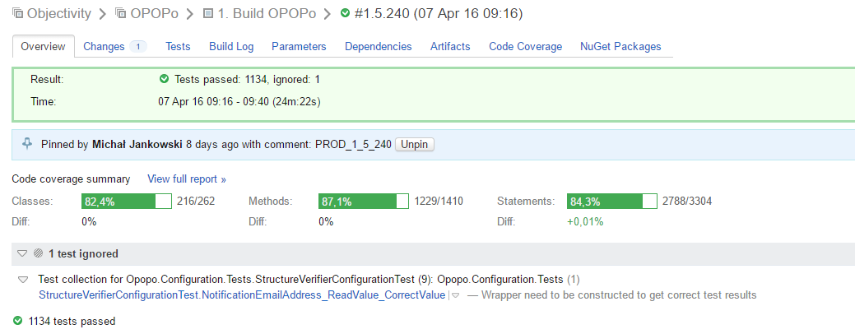
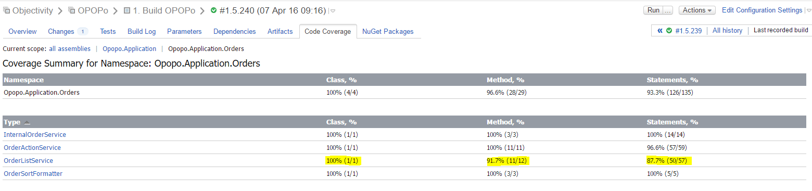
Team CiTY – Coverage ReporT
Notes:
It is hard to set up correct level of code coverage. It is better to look at trend.
You can use exclude.

Slide 64
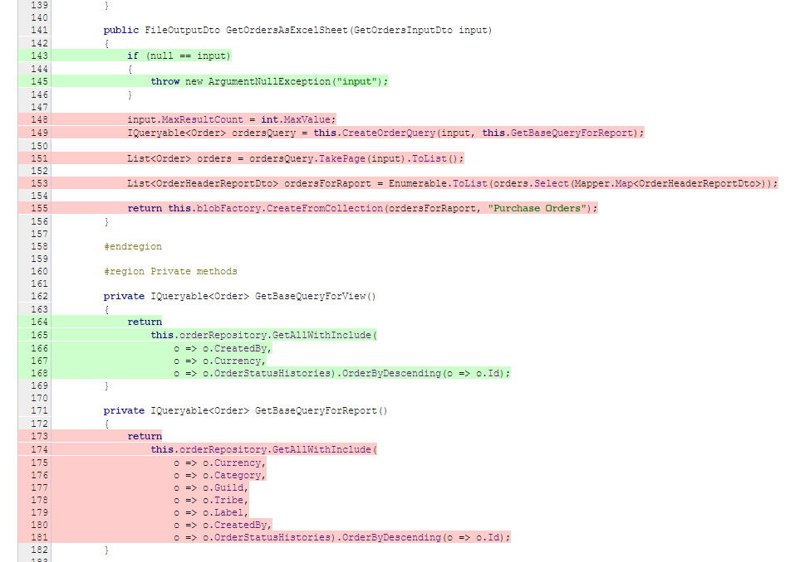
Team CiTY – Lines Coverage

Slide 65
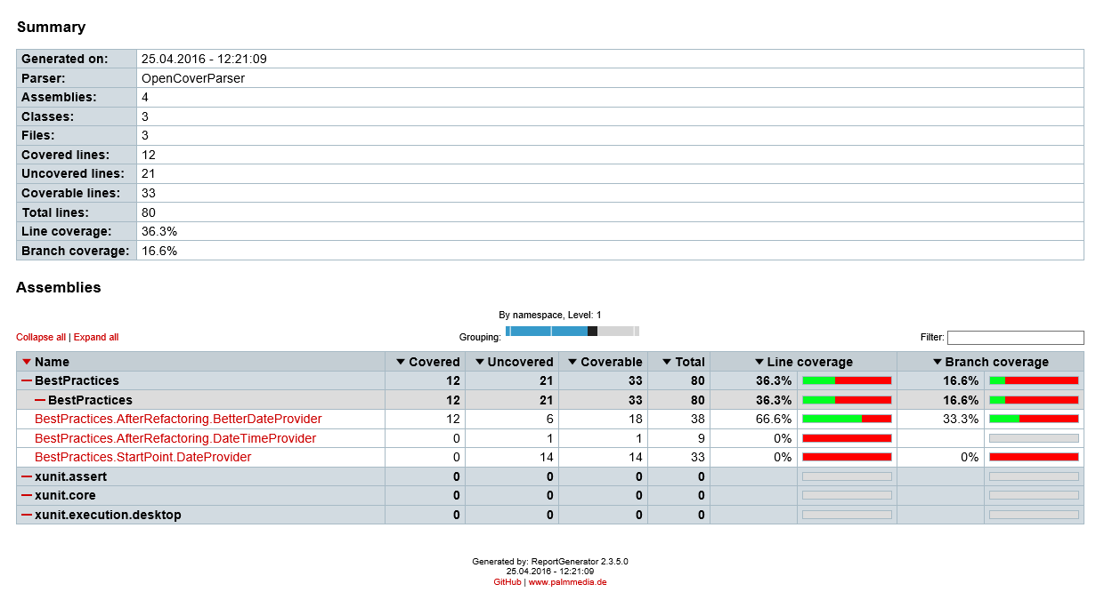
Open COVER – Branch Coverage
https://github.com/OpenCover/opencover/wiki
Notes:
Show:
Run script and show results
http://derekwilson.net/derekblog/post/2012/05/29/Using-OpenCover-and-xUnit.aspx

Slide 66
DATABASE UNIT TESTS

Slide 67
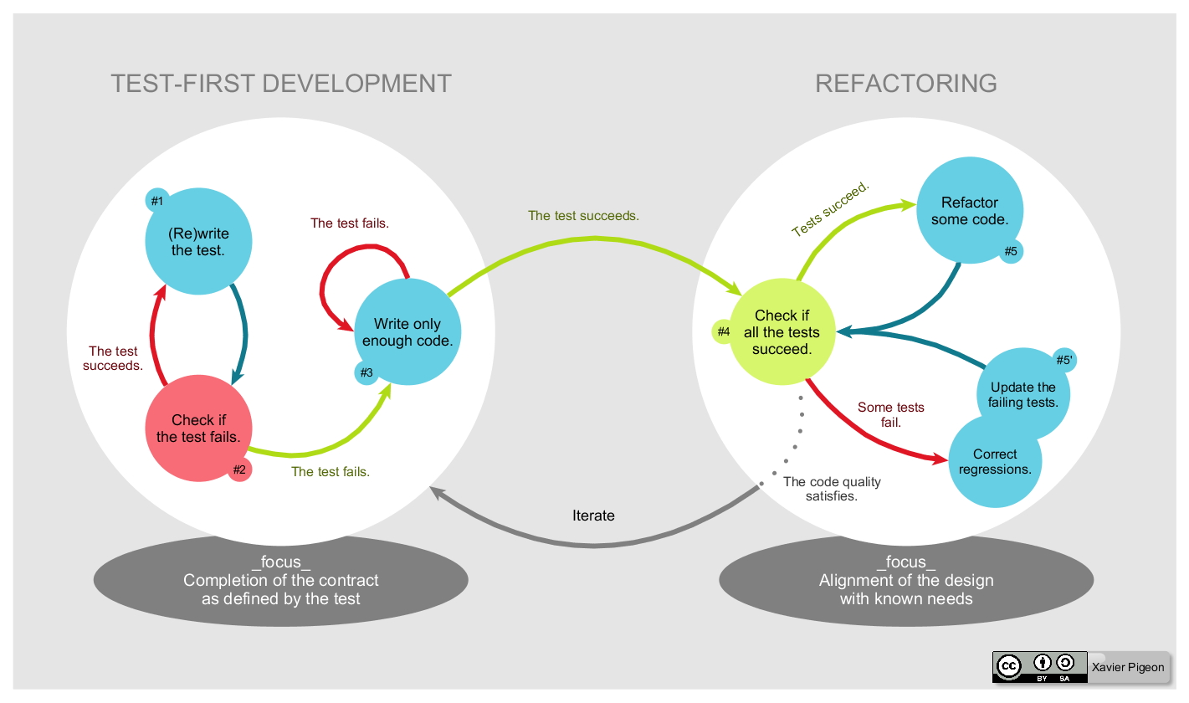
Test Driven Development (TDD)
Notes:
Not everting can be written with this approach.

Slide 68
Summary

Slide 69
Recollect knowledge
You should know test frameworks (nUnit, xUnit, MSTest)
Be able to run and understand unit tests
Be able to write unit tests
Know how to mock behaviour
Check which code has been tested and which not

Slide 70
Links
Presentation and code
xUnit
Moq
NSubstitute
nUnit
FluentValidation
The Art of Unit Testing: With Examples in .NET by Roy Osherove
Xunit Test Patterns: Refactoring Test Code by Gerard Meszaros (content available on page: http://xunitpatterns.com/index.html)

Slide 71
QUESTIONS / Discussion

Slide 72
Thank You
Michał Jankowski
mjankowski@objectivity.co.uk

